Slide 1
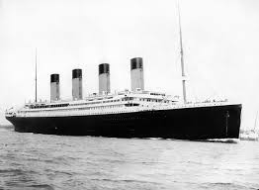
Titanic Machine Learning
Matt Warner, Mike Wunderlich & Tom Matoushek

Slide 2
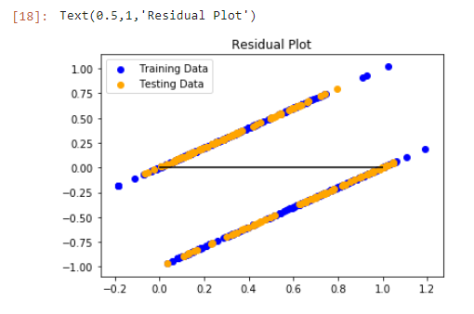

Linear Regression
A logical choice as most people are familiar with this type of analysis
Started out with a low testing score ~10 %
Used only “ready to go” data
Thought this was due to limited dataset
Started cleaning data
Achieved ~ 43% testing score
So, flipping a coin is more predictive than our ML model…..

Slide 3
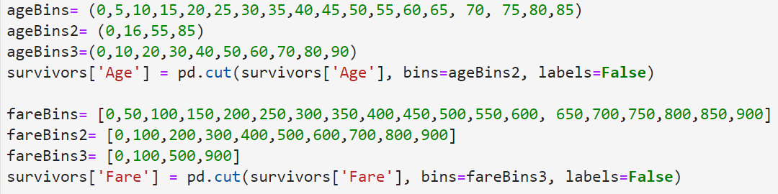
Data Cleanup
Moved onto KNN and more data cleanup
Filled in missing “Age” values with mean of “Age”
Convert Data into Categorical
ML handles categorical data better than continuous
Binning
Drop unused Columns

Slide 4
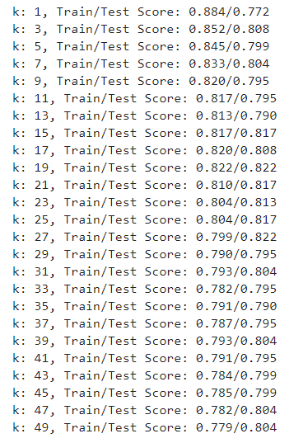
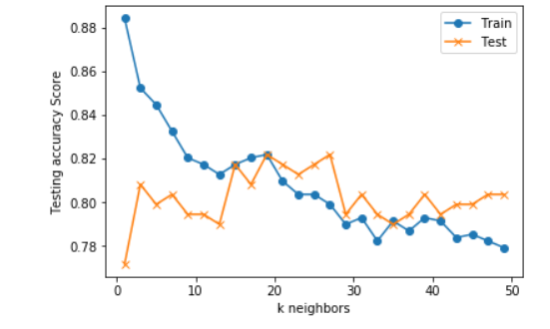
KNN
KNN was the next model tested
K15, 17, 19, 21, 23, 25, 27 similar accuracy
82% was the highest accuracy

Slide 5
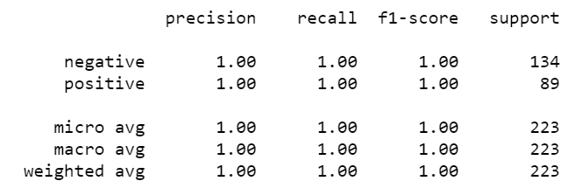
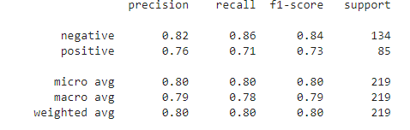
SVM
100% Accuracy! Hooray!
Initial results were questionable….
Accidently used “Survived” Column in training/testing data ☺
Added Cleaned data
Achieved about 0.80 f1 score

Slide 6
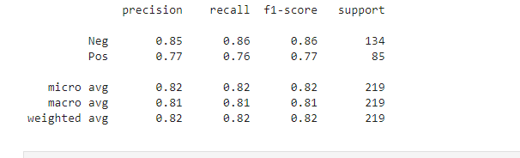
Logistic Regression
Achieved an f1 score of 0.82
Much better than Linear Regression!

Slide 7
Future Possibilities for Improvement
Create features with the columns that were dropped
Create more features of any kind
Adjust SVM or logistic regression parameters
Explore Other Models

Slide 8
Final Thoughts
Machine Learning seems to be a “Last Mile” problem
Relatively easy to get to a certain point
Extremely difficult to get beyond that point
All gains are incremental
Build a library to have functionality to explore all permutations of created features/bins etc… and graph them.
Difficult to go through each permutation by hand
Better to have one notebook that explores each model
We had 4 notebooks

Slide 9
The End Questions???

